Slide 1

Provenance: An Introduction to PROV
Luc Moreau & Paul Groth & Trung Dong Huynh

Slide 2





Acknowledgements

Slide 3
Outline
Notion of Provenance
Examples of Provenance
W3C Provenance Working Group
PROV
Provenance Recipes
Tools / Management
Summary
Hands-on

Slide 4
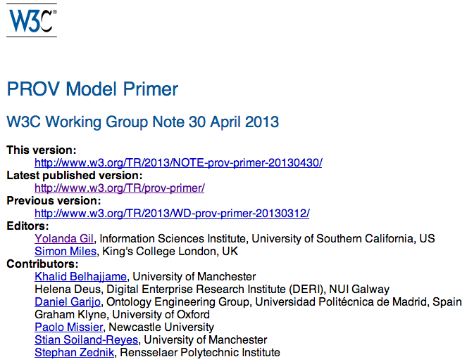
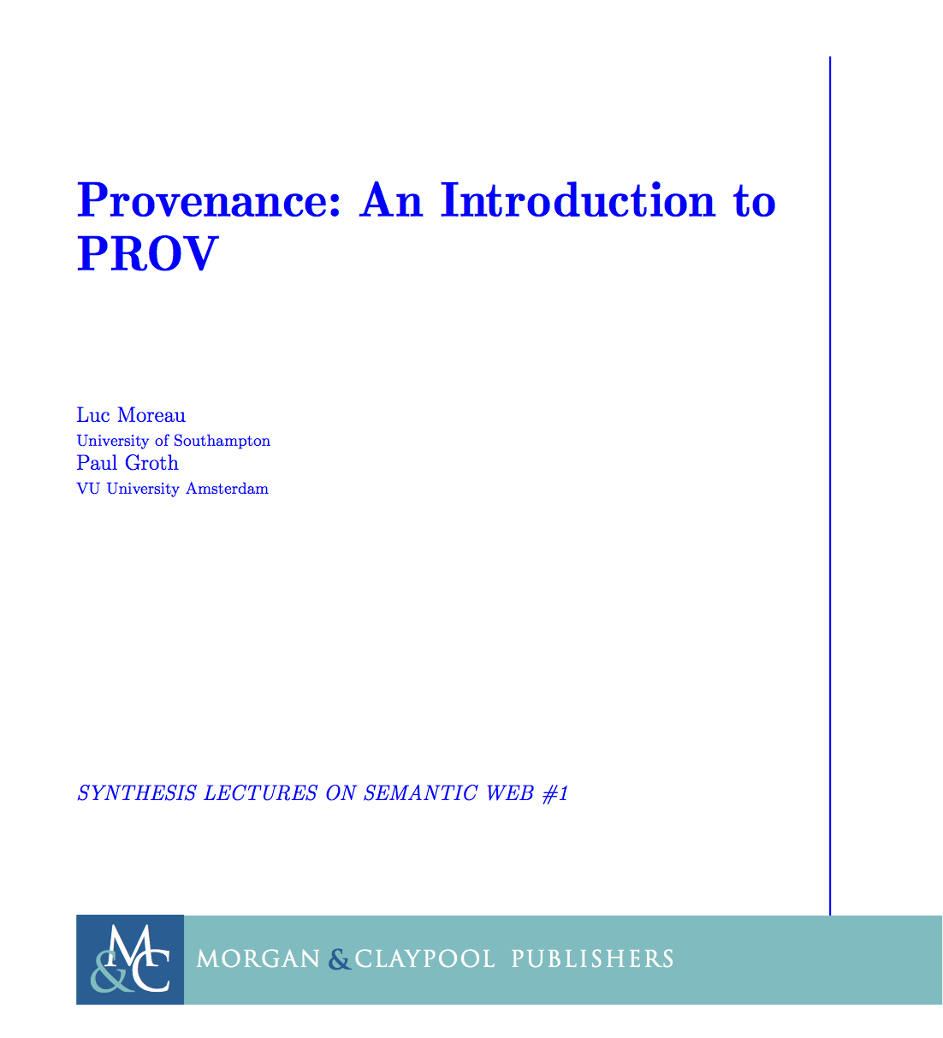
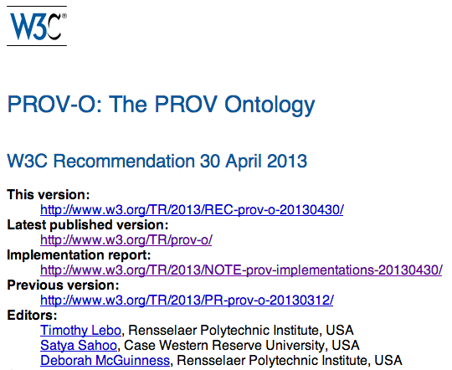
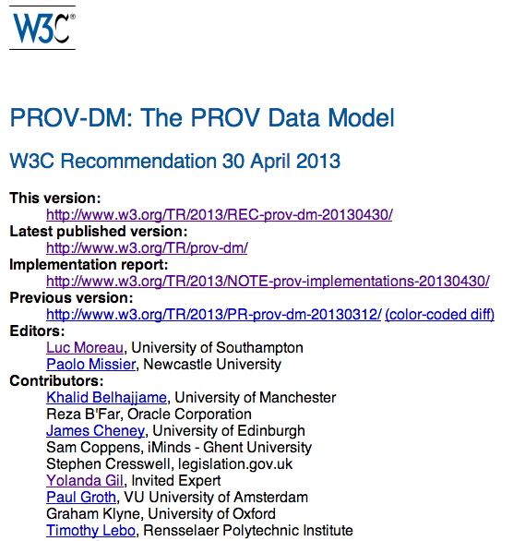
References

Slide 5
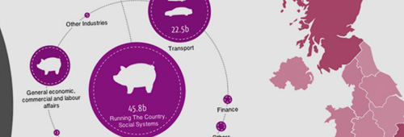
Open Data and Journalism
Data journalism ethos: to expose the data and methods used to produce news items
Data wrangling can introduce errors, data journalists should care about the validity of data; provenance of data should include its primary source, but also all the transformational steps performed by anyone.
http://datadrivenjournalism.net/featured_projects/how_spending_stories_spots_errors_in_public_spending
Notes:
Data journalism: journalistic process whose purpose is to produce news based on data or, more generally, any digital information.

Slide 6
Tracing Information in the Social Web
In the Social Web, users are given the ability to select contents from across the Web, integrate it together, edit it, rate it, publish it and share it with others.
There is a consume-select-curate-share workflow similar to the data wrangling performed by data journalists, but typically require little technical expertise
“Good curation demands good provenance. Provenance is no longer merely the nicety of artists, academics, and wine makers. It is an ethic we expect.”
http://buzzmachine.com/2010/06/27/the-importance-of-provenance/

Slide 7
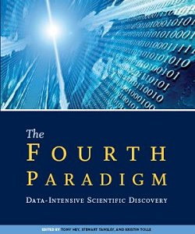
Reproducibility of Science
Science is becoming computation and data intensive, but the fundamental tenet of the scientific method remains unchanged: experimental results need to be reproducible.
Provenance is the equivalent of a logbook
capturing all the steps involved in the derivation of a result,
could be used to replay the execution that led to that result so as to validate it.

Slide 8
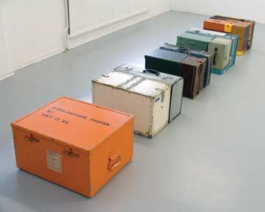
Accountability, Transparency, Compliance in Business Applications
Steve New refers to the provenance of a company’s products, and explains how businesses have changed their practice to make their supply chain transparent, because they worry about quality, safety, ethics, and environmental impact.
Governments increasingly request transparency and provenance information in the area of anti-corruption compliance.
Weitzner notes: provenance is a
substrate that can be used to perform
policy checks and to make systems
accountable.
http://hbr.org/2010/10/the-transparent-supply-chain/ar/1

Slide 9
Provenance Definition
Oxford English Dictionary:
the fact of coming from some particular source or quarter; origin, derivation
the history or pedigree of a work of art, manuscript, rare book, etc.;
concretely, a record of the passage
of an item through its various
owners.

Slide 10
Provenance Definition (2)
Provenance is a record that describes the people, institutions, entities, and activities, involved in producing, influencing, or delivering a piece of data or a thing in the world
Provenance is crucial in deciding:
whether information is to be trusted,
how it should be integrated with other sources, and
how to give credit to its originators when reusing it.
Provenance can help users to make trust judgments.

Slide 11
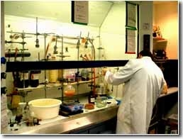
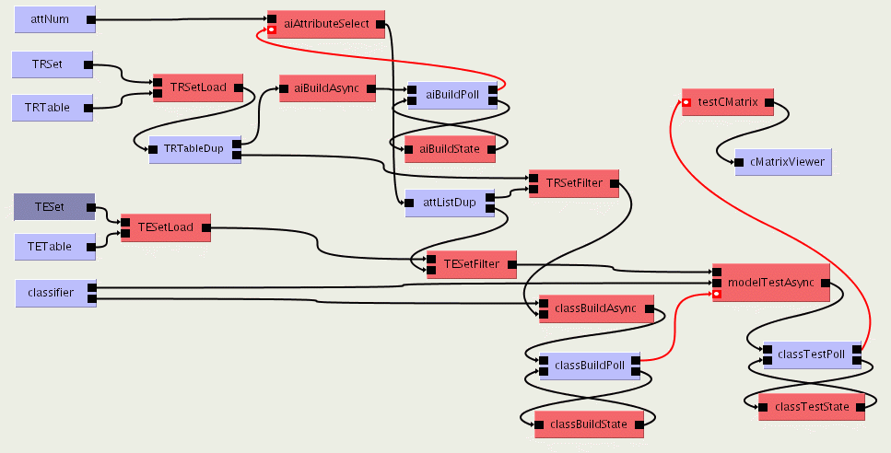
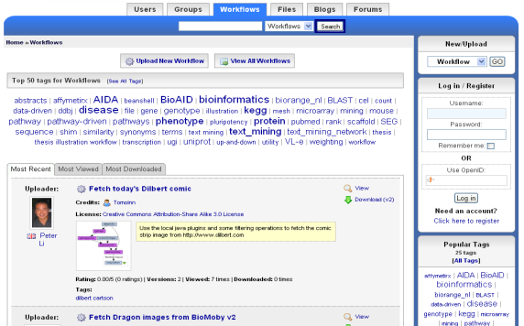

The Science Lifecycle
Virtual Learning Environment
Undergraduate Students
Next Generation Researchers
Digital Libraries
scientists
Graduate Students
Reprints
Peer-Reviewed Journal & Conference Papers
experimentation
Technical Reports
Preprints & Metadata
Local Web
Data, Metadata, Provenance, Scripts, Workflows, Services, Ontologies, Blogs, ...
Repositories
Certified Experimental Results & Analyses
Adapted from David De Roure’s
slides

Slide 12
Virtual Learning Environment
Undergraduate Students
Next Generation Researchers
Digital Libraries
scientists
Graduate Students
Reprints
Peer-Reviewed Journal & Conference Papers
experimentation
Finding the Provenance
of research outputs
across all the systems
data transited through
Technical Reports
Preprints & Metadata
Local Web
Data, Metadata, Provenance, Scripts, Workflows, Services, Ontologies, Blogs, ...
Repositories
Certified Experimental Results & Analyses

Slide 13
Provenance on the Web
Tim Berners-Lee’s “Oh Yeah” button:
A browser button by which the user can express their uncertainty about a document being displayed “so how do I know I can trust this information?”.
Upon activation of the button, the software then retrieves metadata about the document, listing assumptions on which trust can be based.

Slide 14
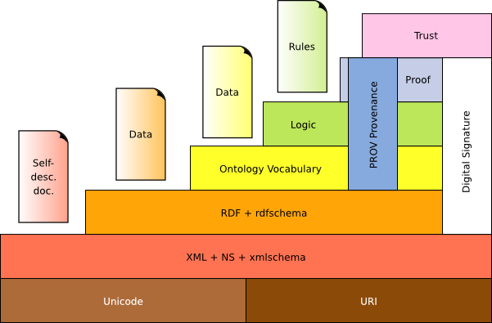
Provenance in the Semantic Web Stack

Slide 15
Example: Data JournaLISM

Slide 16
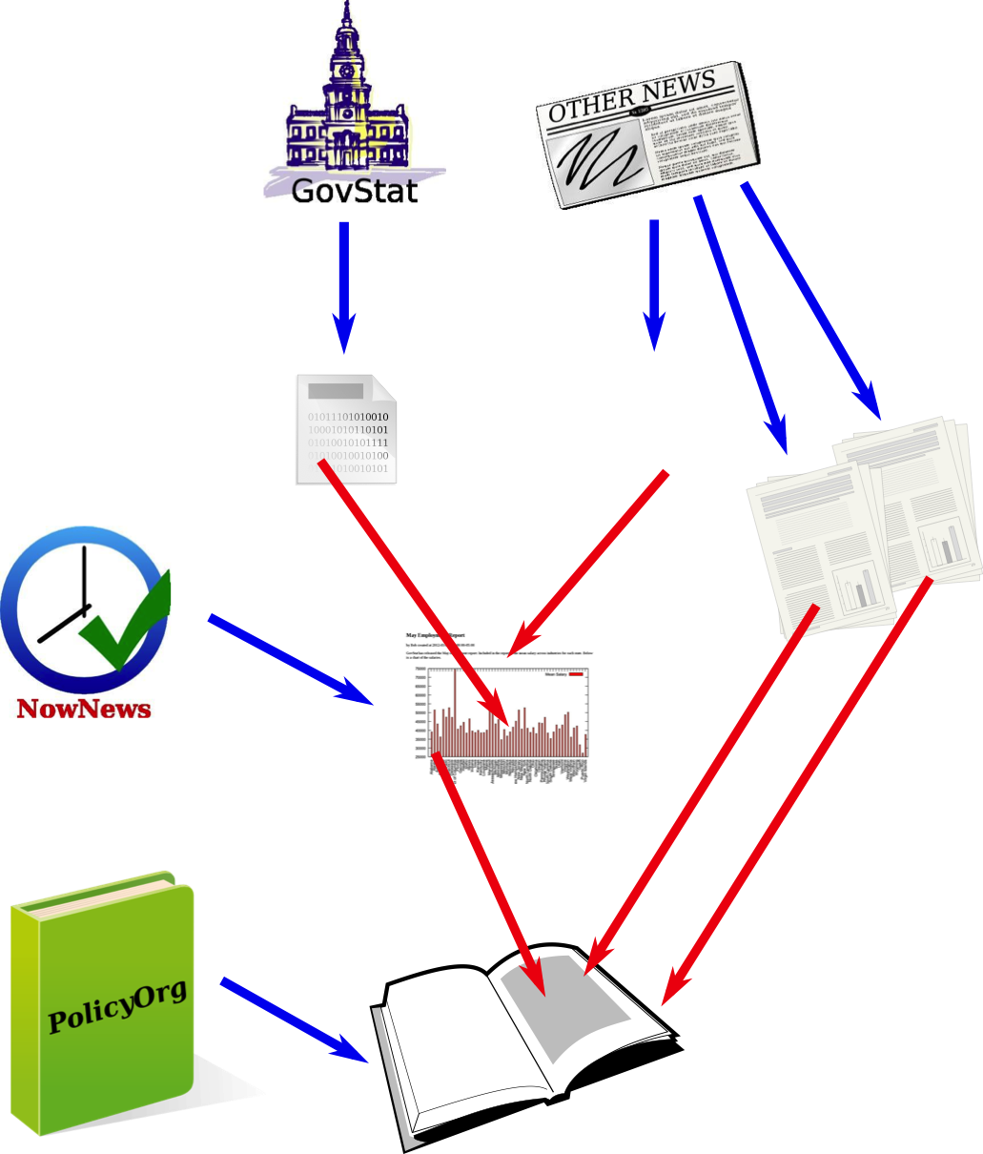
NowNews Publishing
NowNews publishes an article based on the latest employment data published by GovStat
PolicyOrg compiles a report including NowNews article

Slide 17
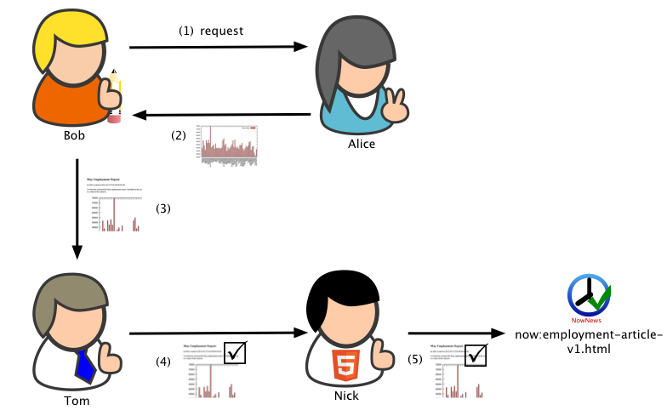
Within NowNews
Bob: Journalist
Alice: Data Cruncher
Tom: Editor
Nick: Web Master

Slide 18
Provenance Use Cases
Quality Assessment
The latest data – timeliness
Finding trusted articles
Finding flawed figures
Compliance
Following policy
Licensing
Cataloging
Building an Index
Acknowledgements
Replay
Reproducibility
Publication Embargo

Slide 19

Use Case: The latest data - timeliness
PolicyOrg is about to issue their report publicly, before releasing the report they want to confirm that the report is based on the most up-to-date data.
One of the figures that they have reused in the report stems from Bob’s article on employment that appeared in NowNews.
PolicyOrg needs to run a check that
ascertains which data that figure was
based upon.

Slide 20

Use Case: Finding trusted articles
When putting together a story or a report, content creators want to find information that is based on trusted sources.
PolicyOrg may want to search for articles based on trusted sources information.
PolicyOrg views data supplied by the government as reliable.
However, when searching for content it is not always clear whether a content source is
derived from data coming from such a
reliable source.

Slide 21
Use Case: Finding flawed figures
Nick, the webmaster, discovers in his final checks before publishing Bob’s article that the included chart seems off, a small state seems to have more employment than a larger one.
Nick wants to find when the error occurred and who was responsible for it so that he can notify them both that there is an error but also where in the production pipeline that error occurred.
In this case, Alice or Bob could use that information to fix the chart.
In general, the question is how to quickly identify the source of errors.

Slide 22
Use Case: Following policy
In order to ensure that articles are of high-quality and fit within the overall editorial vision of the site, NowNews has established a publication policy.
Part of this publication policy is that all posts should be checked by an editor before final publication.
It is up to Nick, the webmaster, to ensure that this check has taken place.
NowNews also does an internal audit every year to ensure that the publication policy has been followed and to identify, in cases where it was not followed, what happened.

Slide 23
Use Case: Licensing
NowNews relies on multiple content providers for content pieces; this includes wire services, stock photo publishers, as well as governmental organizations.
It tries to ensure that the content it reuses is properly attributed and is reused according to the correct license.
However, NowNews is hit with a lawsuit claiming that they are infringing copyright of OtherNews by inappropriately using statistics retrieved from that site.
To defend themselves, NowNews needs to provide the evidence (i.e. the licenses) for all data they acquired from outside organizations.

Slide 24
Use Case: Building an index
To increase both its visibility and authority, NowNews wants to provide an up-to-date catalog of all of the data sources and methods (like scripts) it uses on its website. In addition, this index provides data crunchers, such as Alice, quick access to other data sources and scripts that she might want to use for new stories.

Slide 25
Use Case: Acknowledgments
For many of its articles, NowNews relies on the integration of multiple data sources.
In order to ensure correct credit is given, NowNews wants to provide a central acknowledgments list that recognizes all the people and data sources that contribute to all the various articles and information that it publishes.

Slide 26
Use Case: Reproducibility
When GovStat releases new statistics the current article needs an updated figure.
However, Alice has left the organization so it isn’t clear how the figure was created.
A new data cruncher would like to reproduce what Alice did to create the updated figure.

Slide 27
Use Case: Publication Embargo
GovStat releases its data early to a select set of organizations including NowNews, so that they can prepare articles that are timed to the release of the employment data.
This data is confidential until after the embargo period has elapsed.
Somehow, Bob’s article on the statistics is published before that embargo.
NowNews wants to determine how the confidential data got released.

Slide 28
Attribution
agent
activity
entity

Slide 29
Derivation
agent
activity
entity

Slide 30
Derivation Chain
agent
activity
entity

Slide 31
Activity: Writing Article
agent
activity
entity

Slide 32
Activity Start and End Times
agent
activity
entity

Slide 34
W3C Provenance Working Group

Slide 35
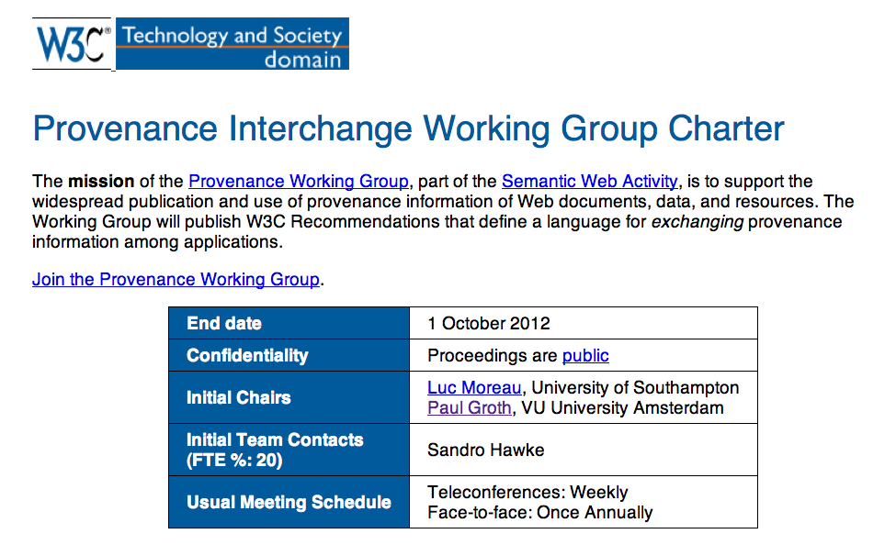

Slide 36
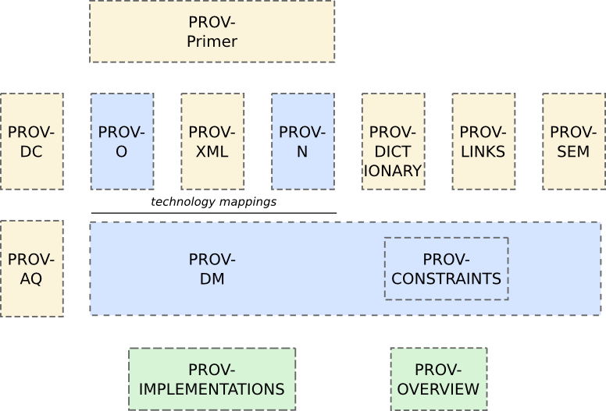
PROV Family of Specifications

Slide 37
PROV

Slide 38
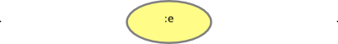
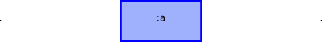
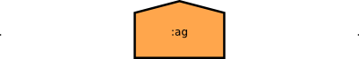
Three Core Classes
An entity is a physical, digital, conceptual, or other kind of thing with some fixed aspects; entities may be real or imaginary.
An activity is something that occurs over a period of time and acts upon or with enti- ties; it may include consuming, processing, transforming, modifying, relocating, using, or generating entities.
An agent is something that bears some form of responsibility for an activity taking place, for the existence of an entity, or for another agent’s activity.

Slide 39
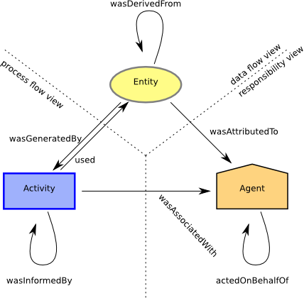
Three Views of Provenance

Slide 40
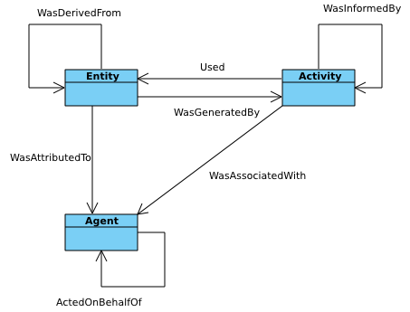
UML View of PROV Core

Slide 41
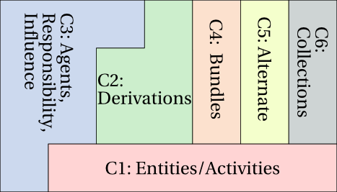
Component Structure for PROV

Slide 42
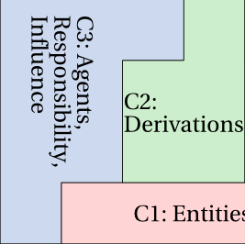
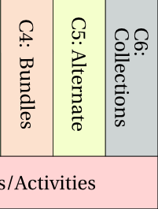
Core vs Extended
Responsibility View
Data Flow View
ProcessView
Core
Extended

Slide 43
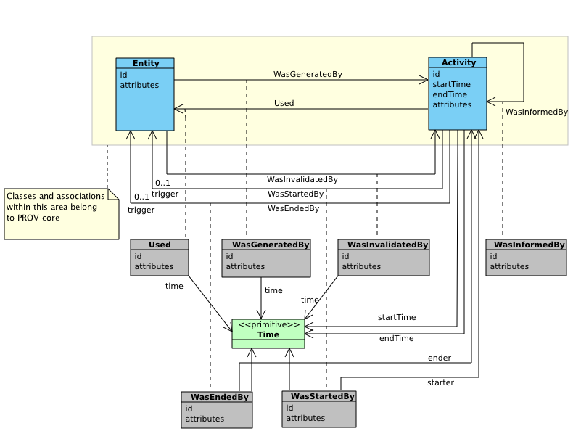
Component 1: Entities and Activities

Slide 44
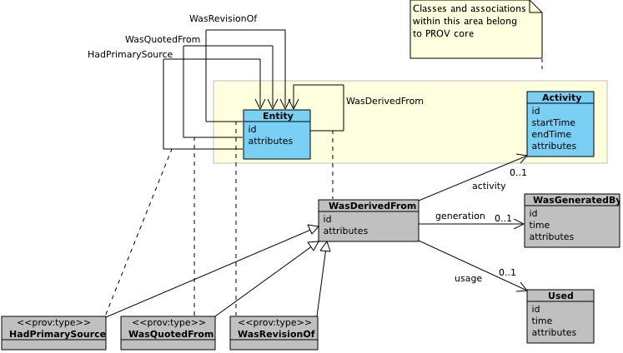
Component 2: Derivation

Slide 45
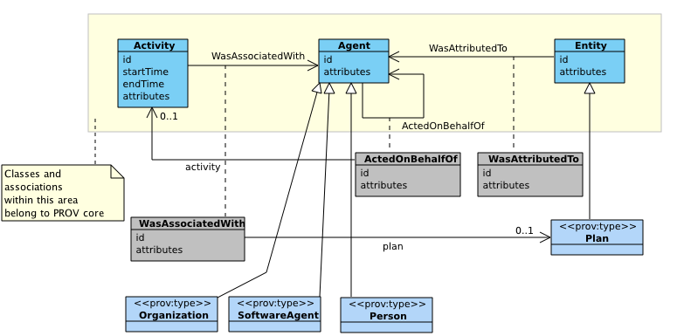
Component 3: Agents, Responsibility…

Slide 46
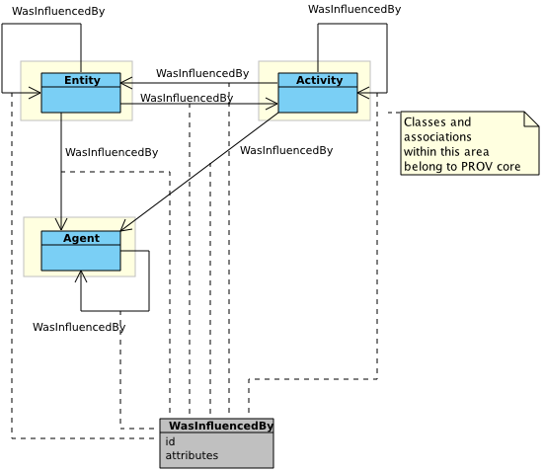
Component 3: … and Influence

Slide 47
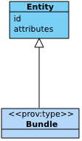
Component 4: Bundles
A Bundle is a named set of provenance assertions
A Bundle is also an entity
Its provenance can be expressed with PROV

Slide 48
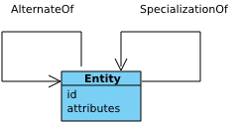
Component 5: Alternate Views

Slide 49
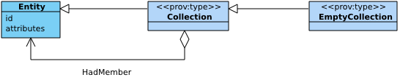
Component 6: Collections

Slide 50
Beyond Binary Relations
In UML, Association Classes are introduced to express n-ary relations

Slide 51
Directed Qualified Pattern
A convention to express n-ary relations in RDF
Flows in the same direction as the unqualified binary relation
Introduces an explicit resource from which extra information can be hooked

Slide 52
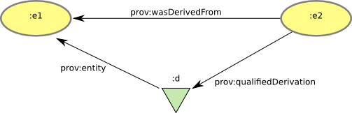
Derivation
A derivation is a transformation of an entity into another, an update of an entity resulting in a new one, or the construction of a new entity based on a pre-existing entity.
Unqualified
:e2 a prov:Entity.
:e1 a prov:Entity.
:e2 prov:wasDerivedFrom :e1.
Qualified
:d a prov:Derivation.
:e2 prov:qualifiedDerivation :d.
:d prov:entity :e1.

Slide 53
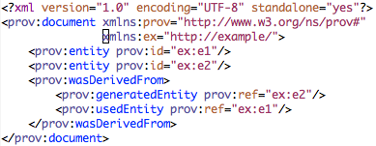
Derivation
document
prefix ex <http://example/>
entity(ex:e1)
entity(ex:e2)
wasDerivedFrom(ex:e2, ex:e1)
endDocument
@prefix prov: <http://www.w3.org/ns/prov#> .
@prefix xsd: <http://www.w3.org/2001/XMLSchema#> .
@prefix ex: <http://example/> .
ex:e1 a prov:Entity .
ex:e2 a prov:Entity ;
prov:wasDerivedFrom ex:e1 .
{
"entity": {
"ex:e2": {},
"ex:e1": {}
},
"prefix": {
"xsd": "http://www.w3.org/2001/XMLSchema",
"prov": "http://www.w3.org/ns/prov#",
"ex": "http://example/"
},
"wasDerivedFrom": {
"_:wDF15": {
"prov:generatedEntity": "ex:e2",
"prov:usedEntity": "ex:e1"
}
}
}

Slide 54
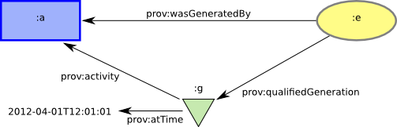
Generation
Generation is the completion of production of a new entity by an activity. This entity did not exist before generation and becomes available for usage after this generation.
Unqualified
:e a prov:Entity.
:a a prov:Activity.
:e prov:wasGeneratedBy :a.
Qualified
:g a prov:Generation.
:e prov:qualifiedGeneration :g.
:g prov:activity :a.
:g prov:atTime "2012-04-01T12:01:01"^^xsd:dateTime.

Slide 55
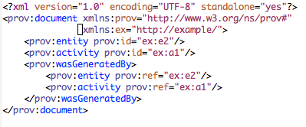
Generation
document
prefix ex <http://example/>
entity(ex:e2)
activity(ex:a1)
wasGeneratedBy(ex:e2, ex:a1)
endDocument
@prefix prov: <http://www.w3.org/ns/prov#> .
@prefix xsd: <http://www.w3.org/2001/XMLSchema#> .
@prefix ex: <http://example/> .
ex:e2 a prov:Entity .
ex:a1 a prov:Activity .
ex:e2 prov:wasGeneratedBy ex:a1 .
{
"wasGeneratedBy": {
"_:wGB13": {
"prov:activity": "ex:a1",
"prov:entity": "ex:e2"
}
},
"entity": {
"ex:e2": {}
},
"prefix": {
"xsd": "http://www.w3.org/2001/XMLSchema",
"prov": "http://www.w3.org/ns/prov#",
"ex": "http://example/"
},
"activity": {
"ex:a1": {}
}
}

Slide 56
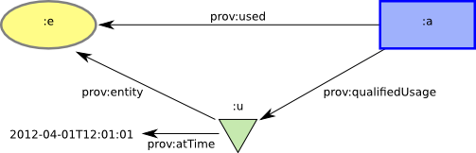
Usage
Usage is the beginning of utilizing an entity by an activity. Before usage, the activity had not begun to utilize this entity and could not have been affected by the entity.
Unqualified
:e a prov:Entity.
:a a prov:Activity.
:a prov:used :e.
Qualified
:u a prov:Usage.
:a prov:qualifiedUsage :u.
:u prov:entity :e.
:u prov:atTime "2012-04-01T12:01:01"
^^xsd:dateTime.

Slide 57
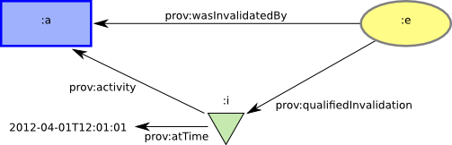
Invalidation
Invalidation is the start of the destruction, cessation, or expiry of an existing entity by an activity. The entity is no longer available for use (or further invalidation) after invalidation.
Unqualified
:e a prov:Entity.
:a a prov:Activity.
:e prov:wasInvalidatedBy :a.
Qualified
:i a prov:Invalidation.
:e prov:qualifiedInvalidation :i.
:i prov:activity :a.
:i prov:atTime "2012-04-01T12:01:01"^^xsd:dateTime.

Slide 58
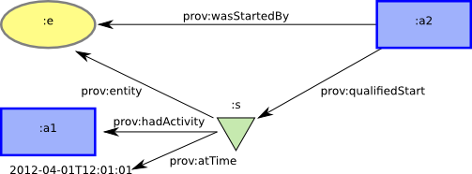
Start
Start is when an activity is deemed to have been started by an entity, known as trigger. The activity did not exist before its start.
Unqualified
:a2 a prov:Activity.
:e a prov:Entity.
:a2 prov:wasStartedBy :e.
Qualified
:s a prov:Start.
:a2 prov:qualifiedStart :s.
:s prov:entity :e.
:s prov:hadActivity :a1.
:s prov:atTime "2012-04-01T12:01:01"^^xsd:dateTime.

Slide 59
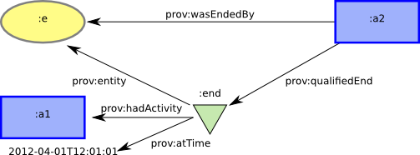
End
End is when an activity is deemed to have been ended by an entity, known as trigger. The activity no longer exists after its end.
Unqualified
:a2 a prov:Activity.
:e a prov:Entity.
:a2 prov:wasEndedBy :e.
Qualified
:end a End.
:a2 prov:qualifiedEnd :end.
:end prov:entity :e.
:end prov:hadActivity :a1.
:end prov:atTime "2012-04-01T12:01:01"^^xsd:dateTime.

Slide 60
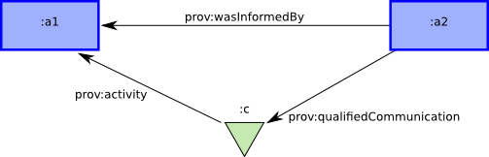
Communication
Communication is the exchange of some unspecified entity by two activities, one activity using some entity generated by the other.
Unqualified
:a2 a prov:Activity.
:a1 a prov:Activity.
:a2 prov:wasInformedBy :a1.
Qualified
:c a prov:Communication.
:a2 prov:qualifiedCommunication :c.
:c prov:activity :a1

Slide 61
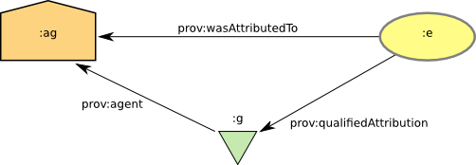
Attribution
Attribution is the ascribing of an entity to an agent.
Unqualified
:e a prov:Entity.
:ag a prov:Agent.
:e prov:wasAttributedTo :ag.
Qualified
:attr a prov:Attribution.
:e prov:qualifiedAttribution :attr.
:attr prov:agent :ag.

Slide 62
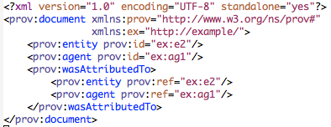
Attribution
document
prefix ex <http://example/>
entity(ex:e2)
agent(ex:ag1)
wasAttributedTo(ex:e2, ex:ag1)
endDocument
@prefix prov: <http://www.w3.org/ns/prov#> .
@prefix xsd: <http://www.w3.org/2001/XMLSchema#> .
@prefix ex: <http://example/> .
ex:e2 a prov:Entity .
ex:ag1 a prov:Agent .
ex:e2 prov:wasAttributedTo ex:ag1 .
{
"wasAttributedTo": {
"_:wAT5": {
"prov:agent": "ex:ag1",
"prov:entity": "ex:e2"
}
},
"entity": {
"ex:e2": {}
},
"prefix": {
"xsd": "http://www.w3.org/2001/XMLSchema",
"prov": "http://www.w3.org/ns/prov#",
"ex": "http://example/"
},
"agent": {
"ex:ag1": {}
}
}

Slide 63
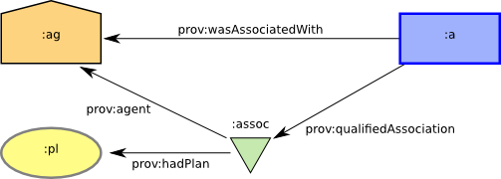
Association
An association is an assignment of responsibility to an agent for an activity, indicating that the agent had a role in the activity. It further allows for a plan to be specified,.
Unqualified
:a a prov:Activity.
:ag a prov:Agent.
:a prov:wasAssociatedWith :ag.
Qualified
:assoc a prov:Association.
:pl a prov:Plan.
:a prov:qualifiedAssociation
:assoc.
:assoc prov:agent :ag.
:assoc prov:hadPlan :pl.

Slide 64
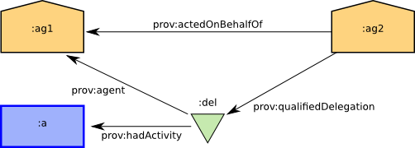
Delegation
Delegation is the assignment of authority and responsibility to an agent to carry out a specific activity as a delegate or representative.
Unqualified
:ag2 a prov:Agent.
:ag1 a prov:Agent.
:ag2 prov:actedOnBehalfOf :ag1.
Qualified
:del a prov:Delegation.
:a a prov:Activity.
:ag2
prov:qualifiedDelegation
:del.
:del prov:agent :ag1.
:del prov:hadActivity :a.

Slide 65
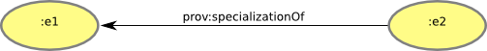
Specialization
An entity that is a specialization of another shares all aspects of the latter, and additionally presents more specific aspects of the same thing as the latter.
:e2 prov:specializationOf
:e1.

Slide 66
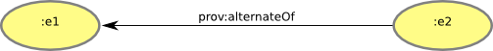
Alternate
An entity that is a specialization of another shares all aspects of the latter, and additionally presents more specific aspects of the same thing as the latter.
:e2 prov:alternateOf :e1.

Slide 67
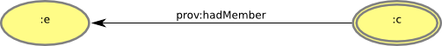
Membership
A collection is an entity that provides a structure to some constituents that must themselves be entities. These constituents are said to be member of the collections.
:c a prov:Collection.
:e a prov:Entity.
:c prov:hadMember :e.

Slide 68
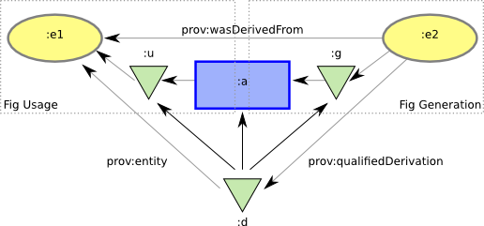
Refined Derivation
A derivation is a transformation of an entity into another, an update of an entity resulting in a new one, or the construction of a new entity based on a pre-existing entity.
Unqualified
:e2 a prov:Entity.
:e1 a prov:Entity.
:e2 prov:wasDerivedFrom :e1.
Qualified
:d a prov:Derivation.
:e2 prov:qualifiedDerivation :d.
:d prov:entity :e1.
:d prov:hadActivity :a.
:d prov:hadGeneration :g.
:e2 prov:hadQualifiedGeneration :g.
:d prov:hadUsage :u.
:a prov:hadQualifiedUsage :u.

Slide 69
Class Hierarchy
A few classes are introduced to provide structure (e.g. InstantaneousEvent)
A few subclasses are introduced for interoperability (e.g. Person)
Developers are invited to extend classes with a blue border (to ensure inter-operability)

Slide 71
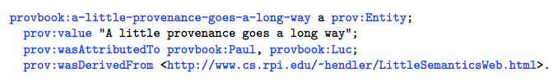

Slide 72
Recipes

Slide 73

Provenance Recipes
Modelling
Organizing
Collecting
Anti-Patterns

Slide 74
Modeling
1.1 Iterative Modeling
1.2 Identify, Identify, Identify!
1.3 From data flow to activities
1.4 Plan for revisions
1.5 Modeling replacement and other destructive activities
1.6 Modeling message passing
1.7 Modeling parameters
1.8 Introduce the execution environment
1.9 Modeling sub-activities

Slide 75
1.1 Iterative Modeling
How does one start to integrate PROV into an application?
Four step approach to integrating PROV:
Identify - The first step is to identify the core data elements (or types) within the application.
Model - Describe how these data elements are connected together via PROV constructs.
Instrument - Modify your application to export PROV according to your model.
Query and Refine - Once the application exports provenance, try a small run of your application, and query the provenance according to provenance use cases.

Slide 76
1.2 Identify, Identify, Identify
How does one ensure that provenance for a data item can be retrieved?
Create an identifier scheme within the application such that all data items get assigned a unique identifier.
Create an identifier scheme using derefenceable URLs.
E.g. http://example.org/data-items/runXXXX/data-element-typeYYYY
where XXXX and YYYY are a numbers.
For each data item, specify the fixed aspects of that item. Fixed aspects are those properties of the data item that do not change, for example, a version number, the identifier itself, the location of the data item, or its content.
Associate each data item to a type and/or a specialization hierarchy. Because data items are produced per execution of an application, embedding it within a structure, for example by giving it a type or associating it to a more general entity helps in writing queries to locate the item.
For every data item, generate an identifier according to the identifier scheme and use it within the provenance.

Slide 77
1.3 From Data Flow To Activities
Which provenance view should be modeled first?
Focus on data first as entities tend to be the most fixed parts of an application.
Express data flow by connecting entities together using prov:wasDerivedFrom properties.
Express responsibility. Once data flow has been expressed, connect the agents that are responsible for each data item using prov:wasAttributedTo properties. At this stage, one can also express which agents acted on behalf of other agents.
Refine data flow and responsibility by introducing activities. We can expand the derivation links to describe how the derivation occurred using the Refined Qualified Derivation

Slide 78
1.4 Plan For Revision
How does one express revisions to a resource or document using PROV?
Collect all the revisions of a resource under a single general resource using prov:specializationOf.
For a resource create an identifier to denote it in general irrespective of its actual version.
For example, the BBC news website.
For each revision of the resource, create a fresh identifier for that resource.
For example, the BBC news website on a given day.
Relate the reversion to the previous one using prov:wasRevisionOf.
Relate each version to the resource in general using prov:specializationOf.

Slide 79
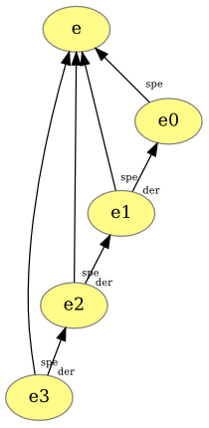
1.4 Plan For Revision
document
prefix ex <http://example/>
entity(ex:e)
entity(ex:e0)
entity(ex:e1)
entity(ex:e2)
entity(ex:e3)
specializationOf(ex:e0,ex:e)
specializationOf(ex:e1,ex:e)
specializationOf(ex:e2,ex:e)
specializationOf(ex:e3,ex:e)
wasDerivedFrom(ex:e1,ex:e0)
wasDerivedFrom(ex:e2,ex:e1)
wasDerivedFrom(ex:e3,ex:e2)
endDocument

Slide 80
1.5 Modeling Replacement
How does one model the replacement of a entity by another?
There are three steps to modeling replacement or other (destructive) activities.
Model the activity itself. In the case of replacement, the Dublin Core PROV mappings provide an activity definition, prov:Replaces that can be used as the activity.
Link the entity being replaced to the activity using the prov:wasInvalidatedBy edge.
Link the new entity that is replacing the older to the Replace activity using the prov:wasGeneratedBy edge.

Slide 81
1.6 Modeling Message Passing
How does one model the exchange of messages between different systems?
Iteratively refine communications introducing new information through the introduction of activities and entities. Consider two activities, a and a2, communicating with each where a2 receives a message from a .
Model the communication using the prov:wasInformedBy relation. :a2 prov:wasInformedBy :a.
Qualify the communication and introduce and activity representing the exchange of a message.
:a2 prov:wasInformedBy :a.
:c a prov:Communication.
:a2 prov:qualifiedCommunication :c .
:c prov:activity :a1.
:exchange a prov:Activity.
:c prov:hadActivity :exchange.
Introduce an entity for the message being passed. We model this as the usage of the entity. Essentially, this models the sending of the message
Complete the modeling of the sending and receiving of the message by introducing a received message and connecting them to the communicating activities.
... :receivedMsg a prov:Entity .
:receivedMsg prov:wasGeneratedBy :exchange .
:a2 prov:used :receivedMsg.
:sentMsg prov:wasGeneratedBy a.

Slide 82
1.7 Modeling Parameters
How does one model parameters of application programs?
Here are 5 steps for modeling usage.
Model each parameter as entity.
Connect the value of the parameter to the entity using prov:value.
Connect the entity to the activity using a prov:used edge.
Qualify the used edge.
Identify the role of the parameter (e.g. -r) using prov:hadRole, and adopting an appropriate namespace for the various roles.
Here is an example describing sort -t ;.
:param a prov:Entity.
:param prov:value ";".
:sort a prov:Activity.
:sort prov:used :param.
:u a prov:Usage.
:sort prov:qualifiedUsage :u.
:u prov:entity :param.
:u prov:hadRole ex:dashT.

Slide 83
1.8 Introduce Execution Environment
Where is an appropriate place to stop modeling provenance?
The key approach to this is the introduction of an execution environment.
This could be the operating system, a workflow system or the environment in activity is run.
Thus, programs and inputs can be provided by the execution environment.
Likewise, ordering of activity execution can be represented with respect to the execution environment.
The execution environment provides the bounds for the provenance being described.

Slide 84
1.9 Modeling Sub-Activities
How does one model activities composed of other activities?
Four steps for modeling sub-activities.
Introduce the individual sub-activities. Ensure that they are within the time boundaries of the larger activity.
Use dct:hasPart to link the sub-activities to the larger activity.
Model explicitly the exchange of entities between the sub-activities.
Use specialization to model when the output or input of the larger activity is the output or input to the sub-activities.

Slide 85
Organizing
2.1 Stitch provenance together
2.2 Use Content-Negotiation when Exposing Provenance
2.3 Bundle up and Provide Attribution to Your Provenance
2.4 Embedding Provenance in HTML
2.5 Embedding Provenance in other Media
2.6 When all else fails, add provenance to http Headers
2.7 Embed Provenance in Bundles: Self-Referential Bundles
2.8 When displaying provenance, adopt conventional layout

Slide 86
2.1 Stitching Provenance Together
How does a consumer of provenance trace back information across multiple components, computers, or organizations?
There are two key rules to enable provenance to stitched together:
Always assert relationships.
In provenance, there should be no entity, activity or agent that stands on its own. They should always be connected to something else by a relation even if that relation points to a component on another system.
Send URLs referring to entities between components.
To allow provenance to be connected across systems, components need to be able to refer to things produced by other components. To ensure that they use common identifiers, components should transmit identifiers for entities when communicating. This can be done in the headers of messages or even embedded in the content itself. When designing a system, it is good to agree on where to locate this shared identifier.

Slide 87
2.2 Use Content-Negotiation When Exposing Provenance
What serialization should I provide provenance in?
PROV was designed to supply provenance in multiple representations catering for different types of development platforms whether they be enterprise XML-based applications or RDF-based Semantic Web applications. Thus, providers should ensure their provenance is useful for a variety of needs by supplying the same provenance data in multiple representations using content-negotation.
For example, for the provenance located at http://www.provbook.org/provenance, the following lists the curl commands to retrieve 3 different representations of the provenance (namely, turtle, svg, and xml):
• curl -sH "Accept: text/turtle" -L http://www.provbook.org/provenance
• curl -sH "Accept: image/svg+xml" -L http://www.provbook.org/provenance
• curl -sH "Accept: application/provenance+xml" -L http://www.provbook.org/provenance
The provenance information corresponding to a particular format can either be generated up-front or produced on the fly. Most web servers and environments support content negotiation.

Slide 88
2.3 Bundle up and provide attribution
How can a consumer of provenance determine the asserter of provenance?
PROV provides a mechanism, referred to as bundle, by which provenance assertions can be packaged up and named.
A bundle is also an entity, so its provenance can be expressed using PROV mechanisms and by referring to its name.

Slide 89
2.4 Embedding Provenance in HTML
How do I make provenance available in a Web page?
All parts of the Web page that provenance needs to be given for must have well defined identifiers
By reference provenance
To refer to a resource containing provenance, we add a prov:has provenance and prov:has anchor statements to the head of the HTML file. For example, we can link to the provenance of the www.provbook.org homepage.
<head>
<link rel="http://www.w3.org/ns/prov#has_provenance"
href="http://www.provbook.org/provenance">
<link rel="http://www.w3.org/ns/prov#has_anchor"
href="http://www.provbook.org/">
</head>
The same pattern applies for referring to provenance stored in a provenance store, using relation prov:has_query_service to denote the store.

Slide 90
2.5 Embedding Provenance in Other Media
I know how to embed provenance metadata in html, but what about other formats, such as jpeg, pdf, or svg?
The solution consists in adding metadata fields prov:has_anchor, prov:has_provenance, and prov:has_query_service to the document, reusing metadata capabilities supported by the specific format.
Note: this was not specified by W3C Provenance Working Group!

Slide 91
2.6 When all else fails, add provenance to HTTP headers
How can we communicate provenance if it is not suitable to embed it in a
resource representation?
PROV allows for provenance-related information to be embedded in http headers. Provenance is passed by reference, by means of a URI pointing to a provenance resource, or to a provenance service.
curl -s -D - http://www.provbook.org/provapi/documents/d001 -o /tmp/foo -H "Accept: application/trig"
HTTP/1.1 200 OK
Date: Wed, 26 Jun 2013 21:57:56 GMT
Server: Apache/2.2.3 (Red Hat)
Content-Location: d001.trig
Vary: negotiate,accept
TCN: choice
Last-Modified: Wed, 26 Jun 2013 21:41:04 GMT
ETag: "18b808f-1350-4e01580a3dc00;18b8091-187-4e01591915b00"
Accept-Ranges: bytes
Content-Length: 4944
Link: <http://www.provbook.org/provapi/documents/d002>;
rel="http://www.w3.org/ns/prov#has_provenance";
anchor="http://www.provbook.org/provapi/documents/d001.trig"
Connection: close
Content-Type: application/trig

Slide 92
2.7 Embed Provenance in Bundles: Self-Referential Bundles
How do we avoid an infinite chain of bundles, each expressing the provenance of a previous bundle in the chain?
By defining a self-referential bundle, which includes its own provenance, one can avoid infinite provenance chains.
The following bundle provapi:d003 describes the provenance of provapi:d003, but it is also self-referential, since it contains its own provenance.
provapi:d003 {
nowpeople:Alice a prov:Agent .
provapi:d002 a prov:Entity , prov:Bundle ;
prov:wasAttributedTo nowpeople:Alice .
provapi:d003 a prov:Entity , prov:Bundle ;
prov:wasAttributedTo nowpeople:Alice .
}

Slide 93
2.8 When displaying PROV, adopt conventional layout
How does one display provenance graphs?
To ensure that people who are familiar with PROV can quickly grasp a visualized provenance graph, the W3C Provenance Working Group has developed a style guide for drawing PROV graphs available at: http://www.w3.org/2011/prov/wiki/Diagrams.

Slide 94
Collecting
3.1 Use structured logs to collect provenance
3.2 Collect in a local form, expose as PROV

Slide 95
3.1 Use Structured Logs To Collect Provenance
What is a simple way to add provenance to a system?
Most programming environments support logging through libraries like log4j (See http://logging.apache.org).
By systematically generating log files that incorporate dependencies between entities, the start and stop time of activities, and the inputs and outputs of activities, one can write a program to extract provenance from the log files.

Slide 96
3.2 Collect in a Local Form, Expose as PROV
In what format should one collect provenance information?
Use the following steps for designing a collection procedure for an application:
Design the collection and storage system for provenance in a way that fits with ap plication requirements. For example, it may be useful to store provenance in a sql database or represent it using logging statements.
Ensure that provenance can converted to PROV extending PROV concepts where needed for the application.
Convert provenance from its internal representation to PROV

Slide 97
Anti-patterns
4.1 Activity but no Derivation
4.2 Association but no Attribution
4.3 Don’t identify prov:Agent, identify responsibility properties

Slide 98
4.1 Activity but no Derivation
Is there a connection between an entity generated by an activity and the entities used by that activity?
There are two solutions to this problem.
One is to introduce explicit derivation edges between entities that are dependent on one another.
The other is to define an application-specific extension to prov:Activity (e.g. Function) that defines each output as being derived from all inputs.
The first solution is somewhat preferable as it makes the derivations explicit and is more interoperable.

Slide 99
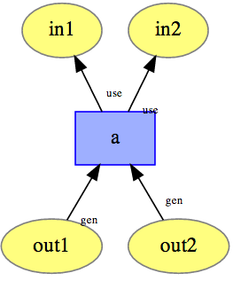

Slide 100


Slide 101
4.2 Association but no Attribution
Are all the entities generated by an activity attributed to the agents that are associated with that activity?
Similar to Recipe 4.1, a solution is to explicitly express the attribution from the entities to the agent that is responsible for them.
In some cases, it may be use to use prov:actedOnBehalf to express chains of responsibility to reduce the number of prov:wasAttributedTo edges linking to one entity.
For example, if an article is attributed to the author who acted on behalf on an editor, then the editor shares some responsibility for the article as well.

Slide 102
4.3 Specify Responsibility First, What a prov:Agent is will follow
Is this person, organization, or software really a prov:Agent?
To avoid confusion, we suggest only applying the type prov:Agent after associating a thing to an activity or entity using a responsibility property such as prov:wasAttributedTo or prov:wasAssociatedWith.
The property prov:actedOnBehalfOf can also be used to create responsibility chains between agents.

Slide 103
Tools

Slide 104

provenance.ecs.soton.ac.uk

Slide 105

ProvValidator

Slide 106

ProvTranslator

Slide 107

ProvStore

Slide 108

ProvVis

Slide 109

ProvToolbox

Slide 110

ProvPy

Slide 111
Even More…

Slide 112

Git2Prov

Slide 113


Slide 114


Slide 115



Slide 116


Slide 117


Slide 118


Slide 119


Slide 120


Slide 121
Conclusion

Slide 122
Concluding Remarks
A data model with core and extended terms
Valid provenance
Serializations into various Web languages
A set of design recipes
Some tools emerging

Slide 123

Further reading
www.provbook.org

Slide 124
Validation

Slide 125
Use Case (1): Version Problem
NowNews provenance indicates that an article includes a quote from another document.
That document happens to be the compilation produced by PolicyOrg. The compilation itself includes the NowNews article.
A circularity occurs in the provenance, which is indicative of a problematic description.

Slide 126
Use Case (2): Date Issue
A plot was computed from a data set. The plot timestamp is found to precede the data set timestamp.
Given that the plot was derived from the data set, this is an indicator of a problem.

Slide 127
Principles of Validation
The intent of validation is to ensure that PROV descriptions represent a consistent history of objects and their interactions.
Once established valid, PROV descriptions are safe to use for the purpose of logical reasoning and other kinds of analysis.

Slide 128
PROV Events
Time is critical for provenance, since it can help corroborate provenance descriptions.
PROV makes no assumption on the clocks being used when asserting time: a unique clock is not expected, nor clocks are expected to be synchronized.
Instead, PROV relies on an event model describing changes in the world.

Slide 129
Five Types of Events
Events
generation
invalidation
usage of entities
start
end of activities
Order
event1 (strictly) precedes event2

Slide 130
Entities Have a Lifetime
Generation precedes invalidation.
Usage follows generation and precedes invalidation.

Slide 131
Activities Have a Lifetime
Start precedes end.

Slide 132
Usage within Activity Lifetime
Usage follows start and precedes end.

Slide 133
Constraints associated with Derivation
Generation of used entity strictly precedes the generation of the derived entity.

Slide 134
Simultaneous Events
Two generation events for an entity occur simultaneously.

Slide 135
Nested Intervals and Specialization
The lifetime of a specialized entity is included in the lifetime of the general entity.

Slide 136
Back to the Example
NowNews provenance indicates that an article includes a quote from the compilation produced by PolicyOrg, which includes the NowNews article.
Event Chart for Use Case: article :art include quote from :c1 and was itself included in :c2. The generation :g1 of :c1 strictly precedes the generation :ga of :art, which strictly precedes the generation :g2 of :c2

Slide 137
Checking Time Annotations
A plot was computed from a data set. The plot timestamp is found to precede the data set timestamp.

